Slide 1
Improving RL Agent for Dilution (Part 5 – Donor Agnostic RL Agent)
Jun 15

Slide 2
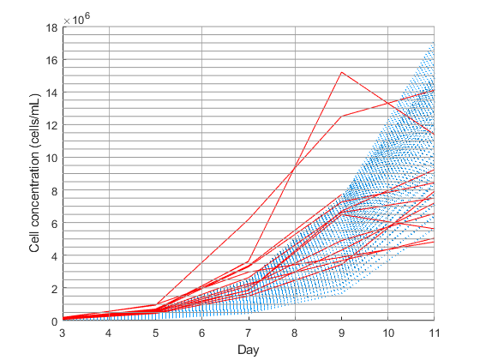
Recall
Example of training (blue) vs validation (red) sets
Blue: Donor UA4 and UA141 logistic models.
Red: Unprocessed donor T054 T046 T051 T062 T031 T052 T038 T036 T066 experimental data.
Fold expansion (cell concentration)

Slide 3
Idea
Can I expect consistent performance from my RL agent when I vary the donors that make up the training and validation data set, out of the list of donors:
T054 T046 T051 T062 T031 T052 T038 T036 T066 UA4 UA141 UA6

Slide 4
3 Particular Conditions
6 randomly chosen (out of 8) T donors plus UA4 and UA141; Epsilon Greedy Decay Rate = 0.00125
6 randomly chosen (out of 8) T donors; Epsilon Greedy Decay Rate = 0.00125
6 randomly chosen (out of 8) T donors; Epsilon Greedy Decay Rate = 0.000625

Slide 5
Simulation Results 1
6 random T donors
+ UA4, UA141
Decay = 0.00125
# episodes = 1500
6 random T donors
only
Decay = 0.00125
# episodes = 1500
6 random T donors
only
Decay = 0.000625
# episodes = 1500

Slide 6
Simulation Results 2
6 random T donors
+ UA4, UA141
Decay = 0.00125
# episodes = 1500
6 random T donors
only
Decay = 0.00125
# episodes = 1500
6 random T donors
only
Decay = 0.000625
# episodes = 1500

Slide 7
Simulation Results 3
6 random T donors
+ UA4, UA141
Decay = 0.00125
# episodes = 1500
6 random T donors
only
Decay = 0.00125
# episodes = 1500
6 random T donors
only
Decay = 0.000625
# episodes = 1500

Slide 8
Simulation Results 4
6 random T donors
+ UA4, UA141
Decay = 0.00125
# episodes = 1500
6 random T donors
only
Decay = 0.00125
# episodes = 1500
6 random T donors
only
Decay = 0.000625
# episodes = 1500

Slide 9
Simulation Results 5
Total reward: 15.971*
Includes U donor penalties that I later took out
~40
6 random T donors
+ UA4, UA141
Decay = 0.00125
# episodes = 1500
6 random T donors
only
Decay = 0.00125
# episodes = 1500
Total reward: 55.878
6 random T donors
only
Decay = 0.000625
# episodes = 1500
Total reward:
41.4

Slide 10
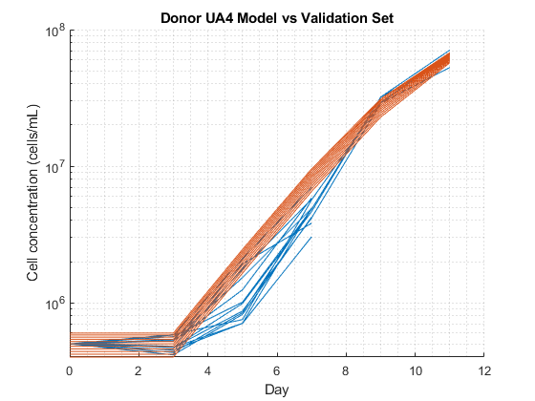
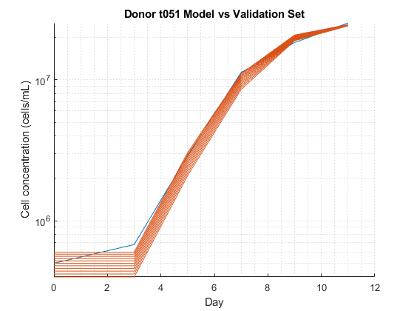
Observation 1
The agent cannot make good dilution decisions for UA4 and UA141 validation data, even when it is only trained on donors UA4 and UA141
-> sign of bad model environment
->
Previously, day 0 to day 3 dynamics were excluded from the environment. But the experimental concentration on day 3 was normalized to inoculation concentration.
-> significant cell growth or death from day 0 to day 3 could hinder the agent’s decision making

Slide 11
Observation 2
Total reward does not vary a lot with training data variation.
Sim # | Seed | Training set donors | Total Reward
1 | 0 | "T046" "T051" "T062" "T031" "T036" "T066" | 54.577
2 | 1 | "T054" "T046" "T051" "T062" "T031" "T038" | 54.577
3 | 2 | "T054" "T046" "T051" "T062" "T031" "T036" | 54.577
4 | 3 | "T054" "T046" "T031" "T052" "T038" "T036" | 54.577
5 | 4 | "T051" "T031" "T052" "T038" "T036" "T066" | 54.577

Slide 12
Observation 3
Epsilon greedy decay rate and number of training episodes are tunable hyperparameters for maximizing reward and minimizing overfitting
Sim # | Epsilon Greedy Decay Rate | # of Training Episodes | Total Reward
1 | 0.005 | 300 | 21.378
2 | 0.00125 | 1500 | 55.878
3 | 0.000625 | 1500 | 41.4
4 | 0.000625 | 2000 | 1.9058

Slide 13
Observation 4
Inoculation concentration = 500k cells/mL

Slide 16
The agent dilutes on day 3 because sometimes the concentration starts to go above threshold as early as day 5
The system does not teach day 0 to day 3 dynamic (since we do not have a model)
The agent guesses based on one concentration only (day 3)
-> Hard to make decisions unless we raise the threshold when we inoculate at 500k cells/mL

Slide 17
Observation 5
Difficulty in teaching the agent to not dilute on day 9 (investigation required)
6 random T donors only
Decay = 0.00125
# episodes = 1500
500k inoculum
6 random T donors only
Decay = 0.00125
# episodes = 1500

Slide 18
Next Steps
Stop experiment condition for concentrations that are too low (<100k)
Normalize day 3?
Compare with logistic equation only

